Slide 1
THE COMPLETE TAROT COURSE

Slide 2
Welcome to Tarot for Women
Thank you for downloading the Prospectus for the Complete Tarot Course.
My passion in life is to ‘Empower Women Through Tarot’. I created Tarot for Women in order to reach women all around the world who wish to learn Tarot from the comfort of their own homes. The Complete Tarot Course gives you everything you need to be successful.

Slide 3
Who am I?
My name is Sinead Fine and I was born and raised in Ireland. I have been reading Tarot professionally since 1997 and teaching Tarot since 2002. I have read for thousands of people internationally and taught hundreds. My teaching method is approachable, down to earth and practical.
For a full list of my qualifications and training, please see page 39.

Slide 4
WELCOME
The Complete Tarot Course………………..…………p5
Who is this Course for?................................... p6
The Complete Tarot Course….......................... p7
Facebook Community …………………………………. p9
Tarot Basics……………………………………….………p11
Certificate in Tarot………………………………….…p13
Live Readings…………………………………………...p25
Three Bonus E-Courses…………………….……….p21
Seven Bonus Lessons…………….………………….p35
Conclusion………………………………………………….p32
Certification………………………………………………..p33
Frequently Asked Questions……………………….p39
Sinead’s Training and Qualifications……………p40

Slide 5
The Complete Tarot Course
The Complete Tarot Course is a comprehensive range
of courses which teaches you everything you need to
know to read Tarot with confidence.
You can take as long as you want to study
the material and coursework. There are no deadlines.
All the material is home study at your own pace.
You can learn anywhere, anytime as long
as you have a computer and internet connection.

Slide 6
Who is this Course for?
This course is designed exclusively for women.
Apart from that small detail ☺ the course
can be for any woman who has an interest in
Tarot, Oracle cards, Divination and a desire to empower herself
through the cards.
This course is for you if you are a Beginner.
It will give you all the basics right through to
advanced skills.
This course is for you if you are an Intermediate
reader. It will help you understand yourself better,
grow in confidence and go deeper with the cards.
This course may even be for you if you are an
Advanced Reader and you are looking for
something fresh, dynamic and enlightening.

Slide 7
The Complete Tarot Course
Now lets explore all the goodies you have received
by buying the Complete Tarot course.
Now and again, I add new materials and
they are all FREE OF CHARGE for you!
You never pay again for any extras
added in the future.

Slide 8
The Complete Tarot Course
Tarot Basics ecourse
Certificate in Tarot ecourse
Supercharge your Intuition ecourse
Easy Oracle cards ecourse
Easy Tea Leaf Reading ecourse
Tarot and Manifestation Masterclass
Tarot and Shamanism Masterclass
Tarot and Masterclass
Tarot and You Masterclass
Tarot and Women’s Mysteries Masterclass
Tarot and Astrology Masterclass
Tarot and Qabala Masterclass
Tarot Resources Database / Library / Audio
Join 2 private Facebook Groups

Slide 9
Facebook
I highly recommend you join our two Facebook private groups.
I recommend all students to join the Facebook Group
Tarot for Women for daily Tips, Tarot news and a
worldwide community of women.
https://www.facebook.com/groups/TarotforWomen/
I also strongly recommend that you join the Facebook Group,
The Diploma in Tarot so you can study alongside other
students and receive support. You will both study the same material.
However, Diploma students can go on to Certification
https://www.facebook.com/groups/diplomaintarot/

Slide 10
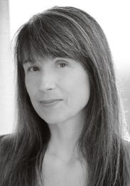
Testimonial
“An online search led me to Tarot for Women and Sinead Fine. Not only did I find a wonderful sense of sisterhood in the Facebook group but an extremely knowledgeable Tarot mentor! Through these courses, I was able to study everything from the meaning behind the Ten of Swords and The Moon card to how to enhance my intuition and discover my Inner High Priestess. The courses invited me to challenge myself on so many levels, not only in learning about the cards and how to do readings but also in discovering how I relate to the Tarot as a woman.
Today, I’m using what I’ve learned at Tarot for Women in my work as a Wise Woman Tarot Consultant and Yoga Instructor, bringing the wisdom of the many faces and stages of womanhood to all of my Wise Woman Tarot guidance-seekers and Yoga students.
Tarot for Women is an excellent choice for any woman
looking to explore the Tarot with supportive and like-minded women!”
Lynda Wisdo, MA, CYT
https://lyndawisdo.weebly.com

Slide 11
Tarot Basics
Tarot Basics is comprised of 9 lessons with a bonus shamanic training lesson.
Lesson One – How I learned Tarot and what you can learn from my experience.
Lesson Two – Explore Tarot and the wonderful world of Tarot Decks. Find one that suits you best.
Lesson Three – Learn about the structure and systems inside of Tarot.
Lesson Four – Discover my secret formula to reading Tarot.
Lesson Five – Learn how to ask the right questions and how to deliver the correct answers.
Lesson Six – Learn about Tarot spreads and get practicing straight away.
Lesson Seven – Myths debunked and popular questions answered.
Lesson Eight – ‘My Top Ten Tips’ for learning Tarot and a Live Reading with analysis.
Lesson Nine – Top Resources to help you take the next steps on your Tarot adventure.

Slide 12
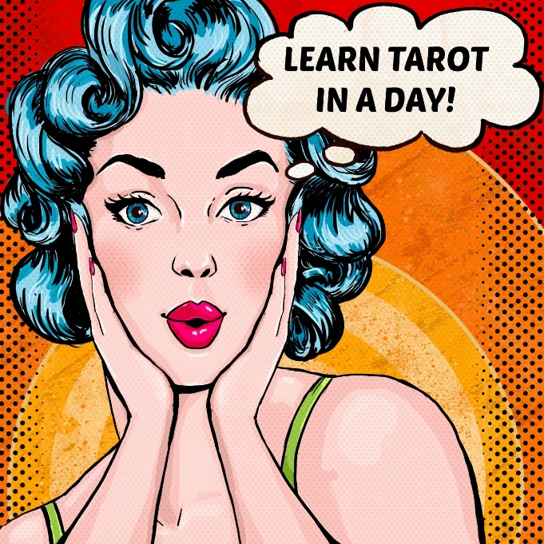
Part One – Tarot Basics
It is advised that you are well practiced in the techniques
described in Tarot Basics before you move onto
the Certificate in Tarot.
I generally recommend repeating the course 2 – 3 times
before moving onto the Certificate.
A house cannot be built without a foundation
and Tarot Basics is a fantastic foundation for your future
Tarot travels.

Slide 13
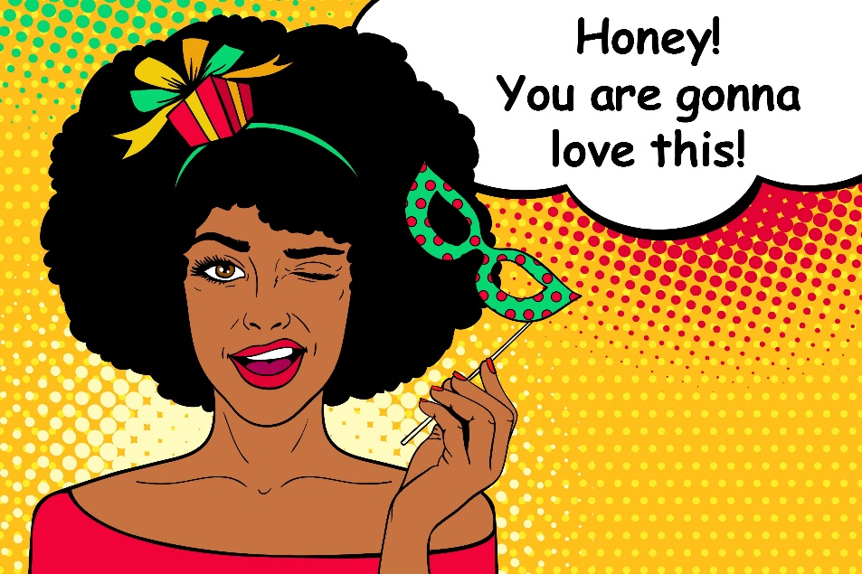
The Certificate in Tarot
The Certificate in Tarot is incredibly comprehensive.
There are 6 modules with 36 video lessons in total.
Each lesson is between 20 – 50 minutes long.
Most lessons have accompanying PDF Cheat sheets,
Workbooks and Exercises.
The lessons are taught in sequence, each building
on the one before it. Therefore it is wise not to skip lessons.
Lets look in depth into each of the 6 modules

Slide 14
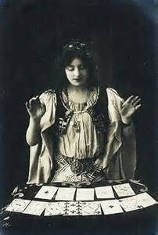
The Certificate in Tarot Module One
This Module is called START
All lessons are video lessons. All workbooks are fillable online or can be downloaded.
Lesson One – Learn how I started reading Tarot. Get an idea of how you might start quickly also. (+PDF Story)
Lesson Two – All about the course, course structure and how to study the material.
Lesson Three – An introduction to Tarot history and popular Tarot decks
in use today. You will also be shown many modern Tarot decks and styles.
Lesson Four – Learn how to bless and dedicate your Tarot deck with
the 4 Elements.

Slide 15
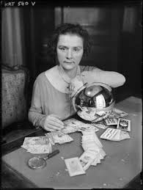
The Certificate in Tarot Module Two
This Module is called STRUCTURE
All lessons are video lessons. All workbooks are fillable online or can be downloaded.
Lesson One – Learn about the structure of the Tarot deck. Never get confused about a card again! (+workbook)
Lesson Two – Welcome to the Major Arcana (+ workbook).
Lesson Three – Learn about the 4 Elements and how they are an integral part of a Tarot deck (+ workbook and keywords cheat sheet).
Lesson Four – Dive into the Court Cards. Learn my easy to follow
method to never get confused about the Court cards again
(+ workbook).
Lesson Five – Welcome to the Minor Arcana (+ workbook).

Slide 16
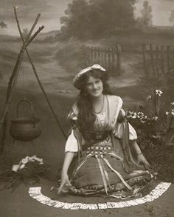
The Certificate in Tarot Module Three
This Module is called STYLE
All lessons are video lessons. Lessons One and Four have extra guided visualisation audios. All workbooks are fillable online or can be downloaded.
Lesson One – Meeting your own Intuition and increasing your psychic skills (+Audio recording, Record Sheet and Q&A Sheet).
Lesson Two – Learn how to use your Tarot cards and create your own unique style.
Lesson Three – My Top Tips for learning Tarot super fast
(+ Daily and Weekly Tarot log).
Lesson Four – Meet a character in the Tarot cards –
a powerful way to understand the cards (+Audio Recording and Record Sheet).
Lesson Five – Ethics and Boundaries. One of the most important
lessons you can learn if you want to read the Tarot for others (+ Workbook).

Slide 17
The Certificate in Tarot Module Four
This Module is called SYSTEMS
All lessons are Video Lessons. All workbooks are fillable online or can be downloaded.
Lesson One – Numbers and Tarot. Learn the system of numbers inside your Tarot deck. Find your Birth and Year card and other interesting facts (+Major Arcana and Numbers Booklet, Workbook).
Lesson Two – Symbols and Tarot. Tarot is rich in symbols. Learn all about the various symbols in Tarot and their meanings (+ Workbook).
Lesson Three – Color and Tarot. Color affects the psychology of a person. Learn about colors and how they apply to Tarot (+ Workbook).
Lesson Four – Astrology and Tarot. A great intro into Tarot and how astrology is embedded in the cards. Learn the astrological signs behind the Major Arcana (+ Workbook).
Lesson Five A/B/C – 3 video lessons about putting your reading into practice. Over 1 hour of tutorials on HOW to read the cards (+ My famous Cheat Sheet on how to interpret a reading).

Slide 18
The Certificate in Tarot Module Five
This Module is called SUCCESS
All lessons are Video Lessons. All Workbooks are fillable online or can be downloaded.
Lesson One – Questions and Tarot. Learn how to ask the right questions so you get the right information every time (+ Workbook).
Lesson Two – Tarot Spreads. Learn all about Tarot spreads – when to use and when not to use. Examples of common spreads (Spreads booklet).
Lesson Three – Practice 3 and 4 cards spreads. Learn how to answer a question by connecting the cards together.
Lesson Four – Learn the Relationship spread. Learn how to interpret the cards by connecting them together into a story – a vital part of Tarot reading.
Lesson Five A/B/C/D – 4 Videos on how to read the cards from beginning to end. How to connect the cards. How to interpret the cards. How to tell a story. How to deliver the message.
Lesson Six – Meet Tamara in a live reading (+ tarot and PDF psychological analysis report).

Slide 19
The Certificate in Tarot Module Six
This Module is called SUPERWOMAN
All lessons are Video Lessons. All Workbooks are fillable online or can be downloaded.
Lesson One – Psychic Development. Get your intuitive skills stronger so you become better as a Tarot reader. Learn about grounding, centering, psychic protection and much more (+ workbook).
Lesson Two – Tarot and Intuition. Go ever deeper with the cards and go on a guided visualization (+ workbook and audio).
Lesson Three – Tarot and Meditation. Learn how meditation will make you an amazing Tarot reader. Learn about different styles and find one that suits your personality the best (+ workbook and audio).
Lesson Four – Tarot and Dreams. Learn how dreams can enhance your Tarot and how Tarot can enhance your dreams (+ workbook).
Lesson Five – Tarot and Women’s Mysteries. A powerful lesson on how you can become more empowered as a woman. Most women cry in this lesson! (+ workbook).
Lesson Six – Tarot Resources. Learn where to go next with your Tarot journey. Vast resources mentioned in a video and Resource book (pdf book).

Slide 20
Testimonial
Sinead is a terrific teacher and I can’t speak
highly enough about her easy to follow
teaching method and motivational approach.
Julia Rudd. Melbourne, Australia. Aromatherapist.
www.happystar.com.au

Slide 21
Supercharge your Intuition E-Course
SUPERCHARGE YOUR INTUITION E-COURSE
One of the most common questions women ask is,
“How do I increase my intuition” or
“How do I gain more confidence in my intuition” or
“How do I know when my intuition is speaking to me”.
So I created Supercharge your Intuition to help
you find answers to all those questions.
The course is comprised of 7 in depth lessons to study
and practice at your own pace.

Slide 22
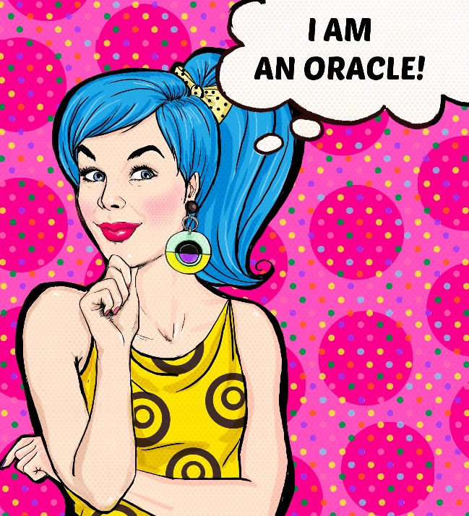
Easy Oracle cards Ecourse
Most women who fall in love with Tarot, also start to use Oracle cards.
The e-course explores in depth how to use Oracle cards
and introduces you to many wonderful decks.
This course is comprised of Five Modules.
Each Module contains between
3 – 4 lessons. A total of over 15 classes.

Slide 23
Easy Tea Leaf Reading Ecourse
I have been reading Tea leaves for years and I discovered
early on that women often loved a cup of tea
with their Tarot reading. At the end of the Tarot reading
I would often read the Tea Leaves in their cup.
If this interests you, then this is a unique course where
I teach you my Irish family tradition of reading cards.
My aunt and Great Aunt are/were Tea Leaf Readers.
The course is comprised of 6 modules,
each containing 3 – 6 lessons. A total of over 20 classes.

Slide 24
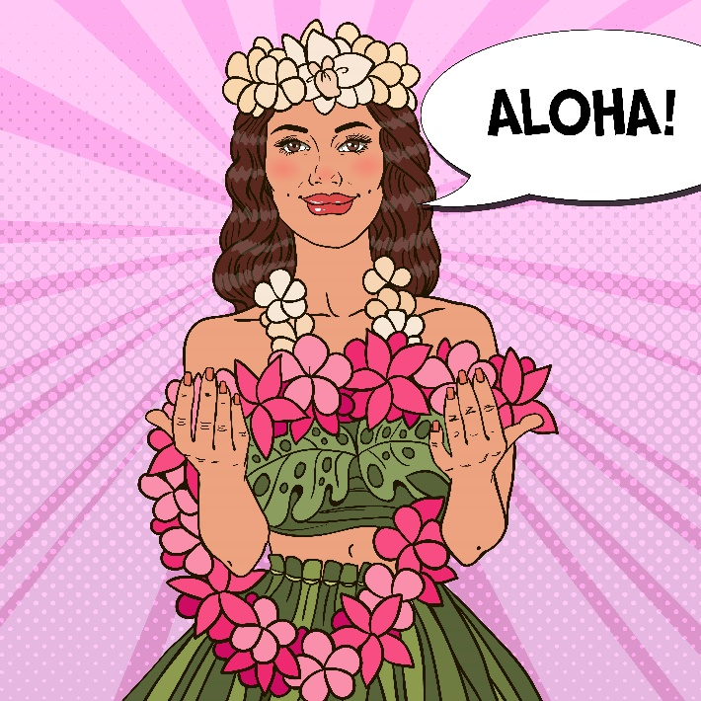
Masterclass Tarot and Shamanism
You might think to yourself,
"What has Shamanism got to do with Tarot?"
After finishing a three year shamanic apprenticeship
many years ago, I can tell you that it has everything
to do with Tarot!
Shamanism makes Tarot come alive like no other
technique that I know.
Here I will teach you a little about Shamanism and
its core techniques. Then I will explain how you can use these techniques with your Tarot cards to explore your own soul mysteries.

Slide 25
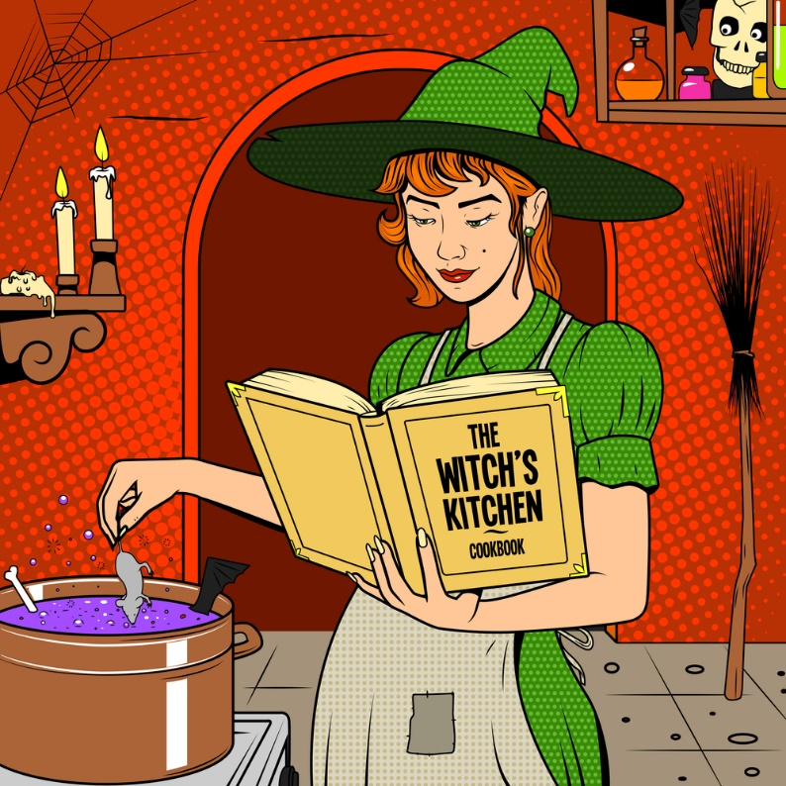
Masterclass Tarot and Manifestation
Manifesting, thinking abundantly and magick are all intertwined.
We have the power to create the future we want.
It is as simple as that. We do not have to be victims of life.
Granted, we cannot control life but we can definitely
decide what we want and aim for it to the best or our ability.
Tarot is a great tool to help you manifest what you want!
I have over 20 years experience working with
Tarot and Magick and it works!!!!

Slide 26
Masterclass Tarot and Love
Love is one of the most common topics covered by Tarot.
No matter where I traveled in the world, the issue of love
came up for the person I was reading for.
As women, love is often a central issue for us.
In my opinion there are three things you need in order to become an expert with the cards and the topic of LOVE, both for yourself and for those you read for.
ONE - Understand the dynamics of relationships
TWO - Understand the love cards in a Tarot pack
THREE - Learn some specific spreads to help with LOVE questions.
This comprehensive lesson covers all the above!

Slide 27
Masterclass Tarot and Your Inner World
What has self development got to do with Tarot?
WHY, EVERYTHING!
The more you understand yourself the better a person
you will be and a better tarot reader you will become.
I will explore self awareness and development in FOUR ways -
ONE - Jungian Psychology
TWO - Self Development Exercises
THREE - Tarot and Dreams
FOUR - How to deal with your Sensitivity

Slide 28
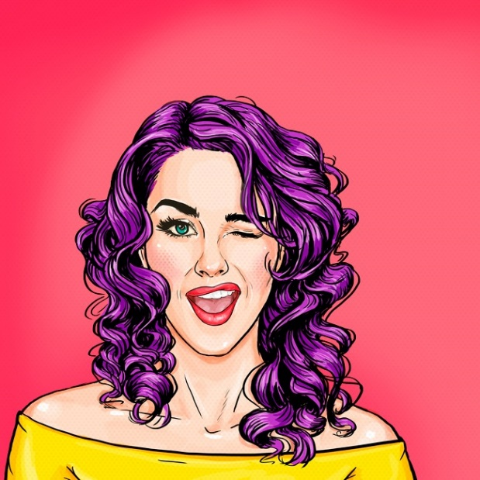
Masterclass Tarot and Women’s Mysteries
Women's Mysteries are those secrets that traditionally only women
were permitted to know. Now thanks to The Red Tent and many other
feminine movements, the mysteries of being a woman are now
being brought back.
You will find how to connect to your Divine Feminine and make it part
of your daily life. You will explore various Tarot spreads that can be
used by women at different times in their lives.
We will explore Women's Mysteries and how Tarot can be
incorporated into the magic of who you are today.
There is nothing more beautiful than a confident empowered woman..

Slide 29
Masterclass Tarot and Astrology
The Tarot is embedded with Astrology.
The Rider Waite deck is based on the Golden Dawn tradition
who were very big into astrology.
Since there are many clones today of the RW deck,
many decks have astrology embedded into them.
This Astrology class will move on from the Certificate Astrology
class and go ever deeper. We will explore your birth chart, the planets,
your Sun, Moon and Ascendant Tarot cards. Your unique Court card,
your cards laid out in the 12 houses, the Golden Dawn system and
much more.

Slide 30
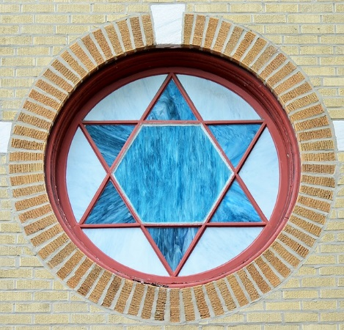
Masterclass Tarot and Qabala
Qabala with a ‘Q’ is a Western Mystery version of Kabbalah which is
the Jewish philosophical quest for understanding God.
The Golden Dawn (an occult group) used Qabala extensively and the
creators of the Rider Waite Smyth deck were members of the Golden Dawn.
Therefore if you want to REALLY understand the Rider Waite Smith deck
or any of its children (about 70% of modern decks are based on the RWS deck),
then at some stage you need to dive into Qabala.
I am a fluent Hebrew speaker (Yes I am Irish but I am married to a Jewish man) so everything you learn and the pronounciations in this unique class will be authentic.

Slide 31
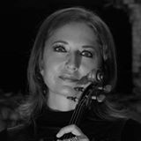
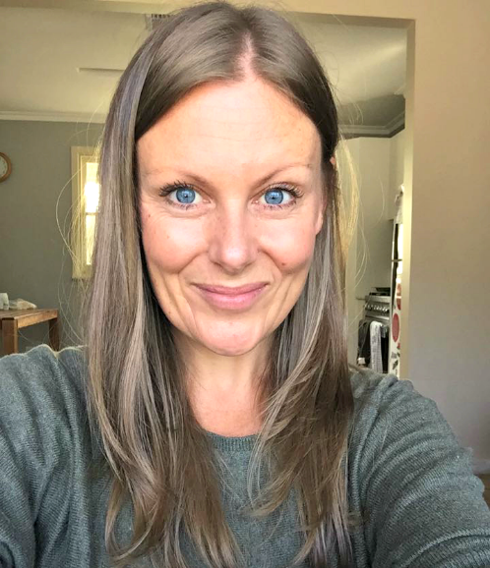
Testimonials
Heather Kaye. Bulgaria. Classical Holistic Violinist.
www.heatherkaye.com
I absolutely adore Sinead’s Academy of Tarot!
Sinead’s charming personality and expertise in Tarot
comes through every video lesson and exercise.
I would recommend this Academy to anyone who
has a sincere desire to discover the mysteries of Tarot.
Brydie Brown. Victoria, Australia. Life Coach, Group Facilitator and Writer.
www.myhandsmyheart.com
Sinead is truly intuitively gifted. Never have I met another so
earthy and intuitive. She follows her heart with such conviction.

Slide 32
Conclusion
This concludes all the details now of your Complete Tarot Course
If you decide to join us we will be excited to see you on the other side
For details about paying in the future to upgrade to get a Diploma in Tarot, please keep reading
For any questions please contact Sinead via the Tarot for Women Facebook Group
or via the Contact page @ tarotforwomen.com

Slide 33
Do you want Certification?
When you sign up for the Complete Tarot Course you may find that you
want a proper qualification at the end. A recognition of all your hard efforts.
If you would like to pay to upgrade to a Diploma in Tarot,
we would be happy to assist you.
You study the material,
take part in the Certification Process and get awarded with
a Diploma of Tarot.
The currant upgrade price is $360. There is also an elite package. Please contact Sinead for more details.
If you DO DECIDE to go for Certification, contact Sinead (contact@tarotforwomen.com).

Slide 34
The Certification Process
If you want to be a Certified Tarot Reader then you must complete the Core Curriculum.
The Core Curriculum consists of 3 areas of study which should be completed in order:
One - The Tarot Basics e-course
Two - The Certificate in Tarot e-course
Three - Live Recorded Tarot Readings with in-depth analysis
Once you complete study in these 3 areas you can then
apply for Certification. Certification occurs in May and November.
In this prospectus we will look at everything in more detail…

Slide 35
The Certification Process
If you decide you want a Diploma in Tarot, then this section is important to read.
Certification takes place twice a year – during the months of May and November.
Each student must complete 3 parts.
One – A 50 question multi choice exam based on the
Core Curriculum. You have one week to compete the exam
and return it via email. You can repeat the exam twice
in a Certification Month. There are no fees to repeat exams.
You must get above 80%.
Two – 5 Live Readings recorded in various formats
Three – A Tarot Project of your choice
All the above material must be handed in during the Certification Month (May or November).

Slide 36
The Certification Process 5 Live Readings
Please record yourself giving 5 Live Readings. This is to help you know how to read Tarot in various ways.
Each reading can be for strangers, friends or family.
One Email Reading – sent to Sinead via email.
One Phone Reading – recorded and sent via email or Facebook Messenger.
Three Live Videos – recorded and sent in a way that suits you best. Most women record with a Smartphone and send via Facebook Messenger.
When you enroll in the Diploma of Tarot, you will be sent a welcome email and all the details about Certification and how to complete these 5 Live Readings.

Slide 37
The Certification Process Project of your Choice
Women say this was the most fun part of the Certification Process!
As you learn Tarot and find your style you will also discover areas you are interested in. Perhaps it is the history of Tarot, the artistic styles, the occult or Qabala.
You decide on a topic, research it and present it in whatever format you want. The project can be as big or small as you decide it to be. It is a way for you to explore an area of Tarot in more depth.
Topics chosen in the past include – written articles on Meditation and Tarot, Buddha and Tarot and Menopause and Tarot. One woman made a musical composition to the Fool. Another woman drew The Empress and the Goddess symbols around her.
You decide what you would like to do. Feel free to talk with Sinead about your desired project and she may be able to give you some guidelines.

Slide 38
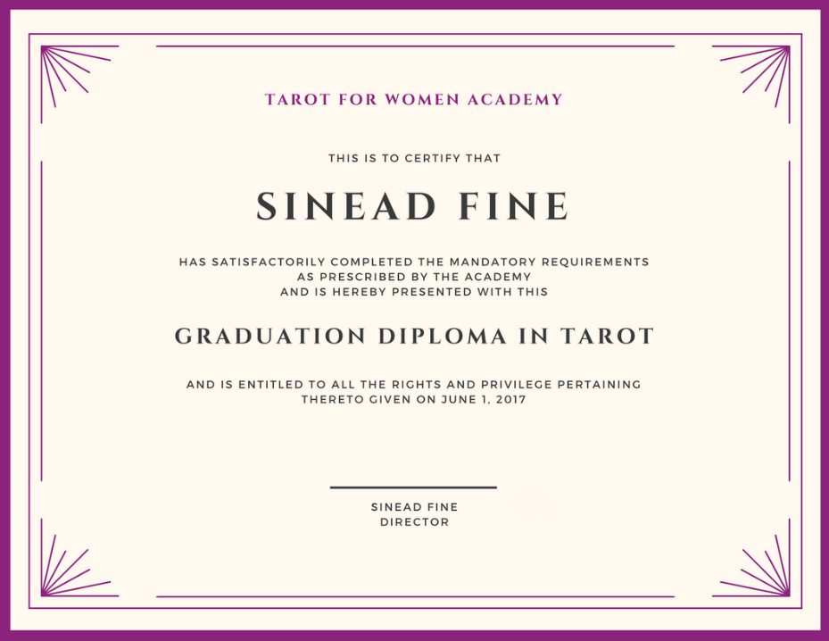
The Certification Process
Once all your materials have been handed in,
Sinead will personally correct them (not staff).
If you receive Certification Sinead will contact you,
organize a time to talk via Skype or
Facebook Messenger for a one hour session of
one to one mentoring. Sinead will give you feedback
and explore the next stage of your journey.
You will then be sent a digital copy of
The Diploma of Tarot to print.
(example shown to the right)

Slide 39
Frequently Asked Questions
For an in-depth FAQ please check the website information page at: https://tarotforwomen.com/faqs/
Can I study from India/Ireland/Australia [insert your country]?
This course is 100% online self-study so as long as you have access to the internet you can study with us. Due to laws in China about our video platform you cannot get access to these courses.
When does the course start?
When you pay, you get instant access to The Complete Tarot Course. You can also pay to upgrade (which you can do anytime) to apply for a Diploma. Application months for the certification process are May and November.
How long does the course take?
As long as you decide it will take. There are no deadlines and you have access for the lifetime of the course.
How do I enroll?
Go to the information page where you found the prospectus and press the BUY NOW button.
Can I ask a question before I enroll?
Of course, just email us at contact@tarotforwomen.com

Slide 40
Qualifications of Sinead Fine Creator of Tarot for Women
TAROT EXPERIENCE
Reading Tarot professionally since 1997 for thousands of people.
Read internationally in the following countries: Ireland, England, Scotland, Belgium, Germany, Holland, Bali, Fiji, Malaysia, Thailand, India, Australia, New Zealand and Israel.
Taught Tarot in the following countries:
Ireland, Holland, India, Australia, Israel and now online!
Read for every type of person and profession:
Stay at Home Moms, Nurses, Doctors, Engineers, Lawyers, Gynacologists, Teachers,
Cleaners, Computer Scientists, Prostitutes, Comedians – you get the idea!
Read regularly in Body, Mind, Spirit Shows, conferences and gatherings.
Read for Tarot businesses' full time and part time.
Built up a strong code of Ethics and Boundaries based on experience which she now teaches.
Taught one on one, small groups, large groups. Led workshops, womens groups and gatherings.

Slide 41
Qualifications of Sinead Fine Creator of Tarot for Women
OTHER QUALIFICATIONS
Many qualifications in Natural Medicine which I bring into my readings and teaching…
BHSc Degree in Homeopathy
Diploma in Reflexology
Diploma in Remedial Massage
Certificate in Stress Management Counselling
NCVA Holistic Health Studies
Reiki Master
Open Heart Meditation
Diploma in Health Food Store Management
OTHER EXPERIENCES
Phone counsellor for various telephone lines over the years: sexual diseases, suicide and depression
Part of various women’s groups promoting empowerment, healing and change since 1998
7 years of Jungian Psychotherapy
Part of Red Tent women’s groups since 2001
Part of a Shamanic Healing Group for 2 years
4 years in an Alexandrian Wiccan Coven reaching 3rd Degree
3 year Shamanic Apprenticeship

